Slide 1




Bayes Rule Revisited
We are provided with a probability model for
Also provided with a probability model for
Want probability model for
is “ground truth”, is “Observation”
Inference:
Detection
Estimation

Slide 2
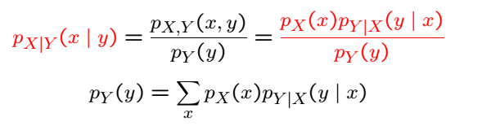
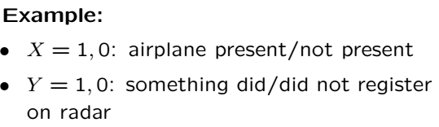
Recall Bayes Rule Discrete
We have already seen

Slide 3

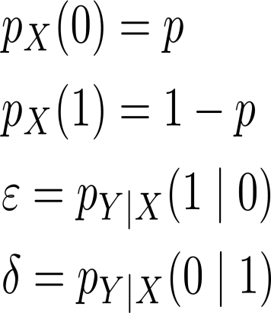

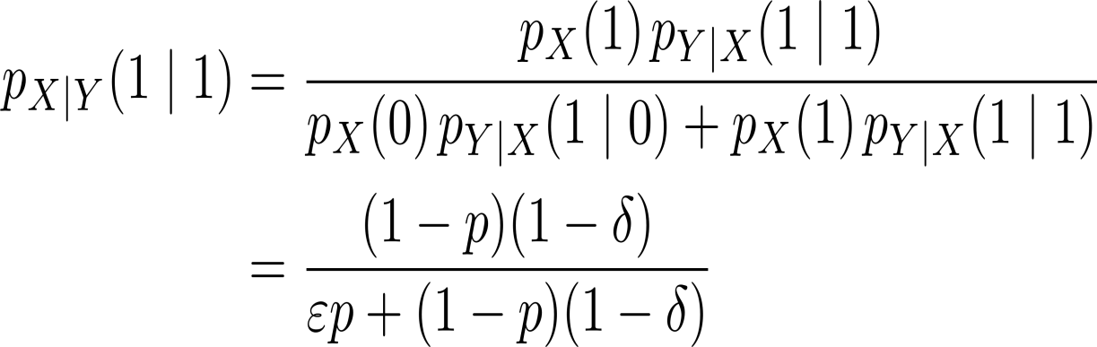


Bayes Rule Discrete Cont’
Probability that these really is a target when our detector says so
Detector accuracy

Slide 4
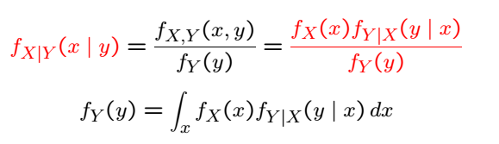
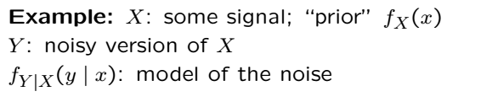
Bayes Rule Continuous

Slide 6






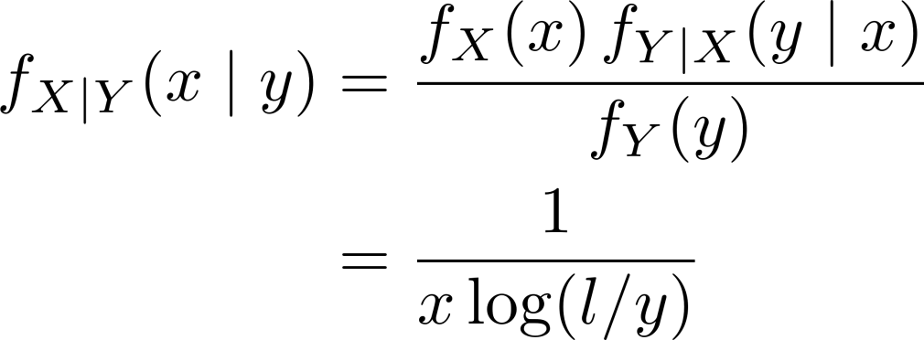



Bayes Rule Continuous Cont’
For stick breaking problem recall
Generate from knowing
Generate from knowing
and are available, what is ?
Can integrate above wrt for a given to find probabilities.

Slide 7
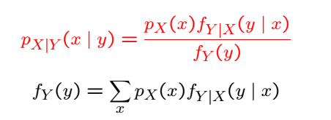
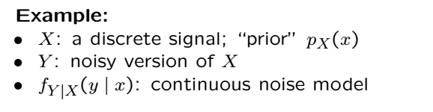
Discrete X Continuous Y

Slide 8


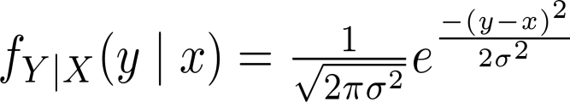
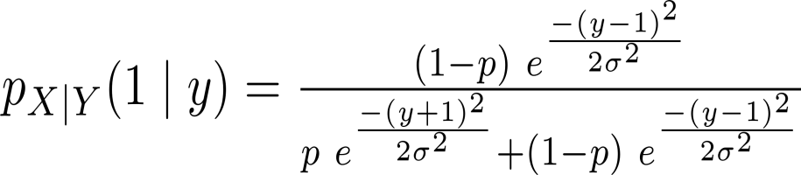
Bayes Rule Discrete Continuous Cont’

Slide 9
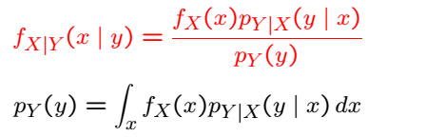
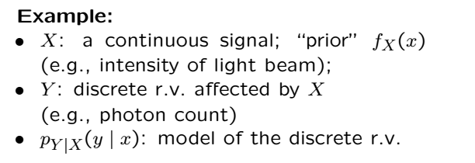
Discrete Y Continuous X

Slide 10
Acknowledgements and Citations
Parts of these slides are adapted from the following resources:
Power Point Lecture Slides for the Textbook http://bcs.wiley.com/hebcs/Books?action=index&bcsId=8676&itemId=1118324560
John Tsitsiklis. 6.041 Probabilistic Systems Analysis and Applied Probability, Fall 2010. (Massachusetts Institute of Technology: MIT OpenCourseWare),http://ocw.mit.edu (Accessed 13 Apr, 2015). License: Creative Commons BY-NC-SA

